Slide 1
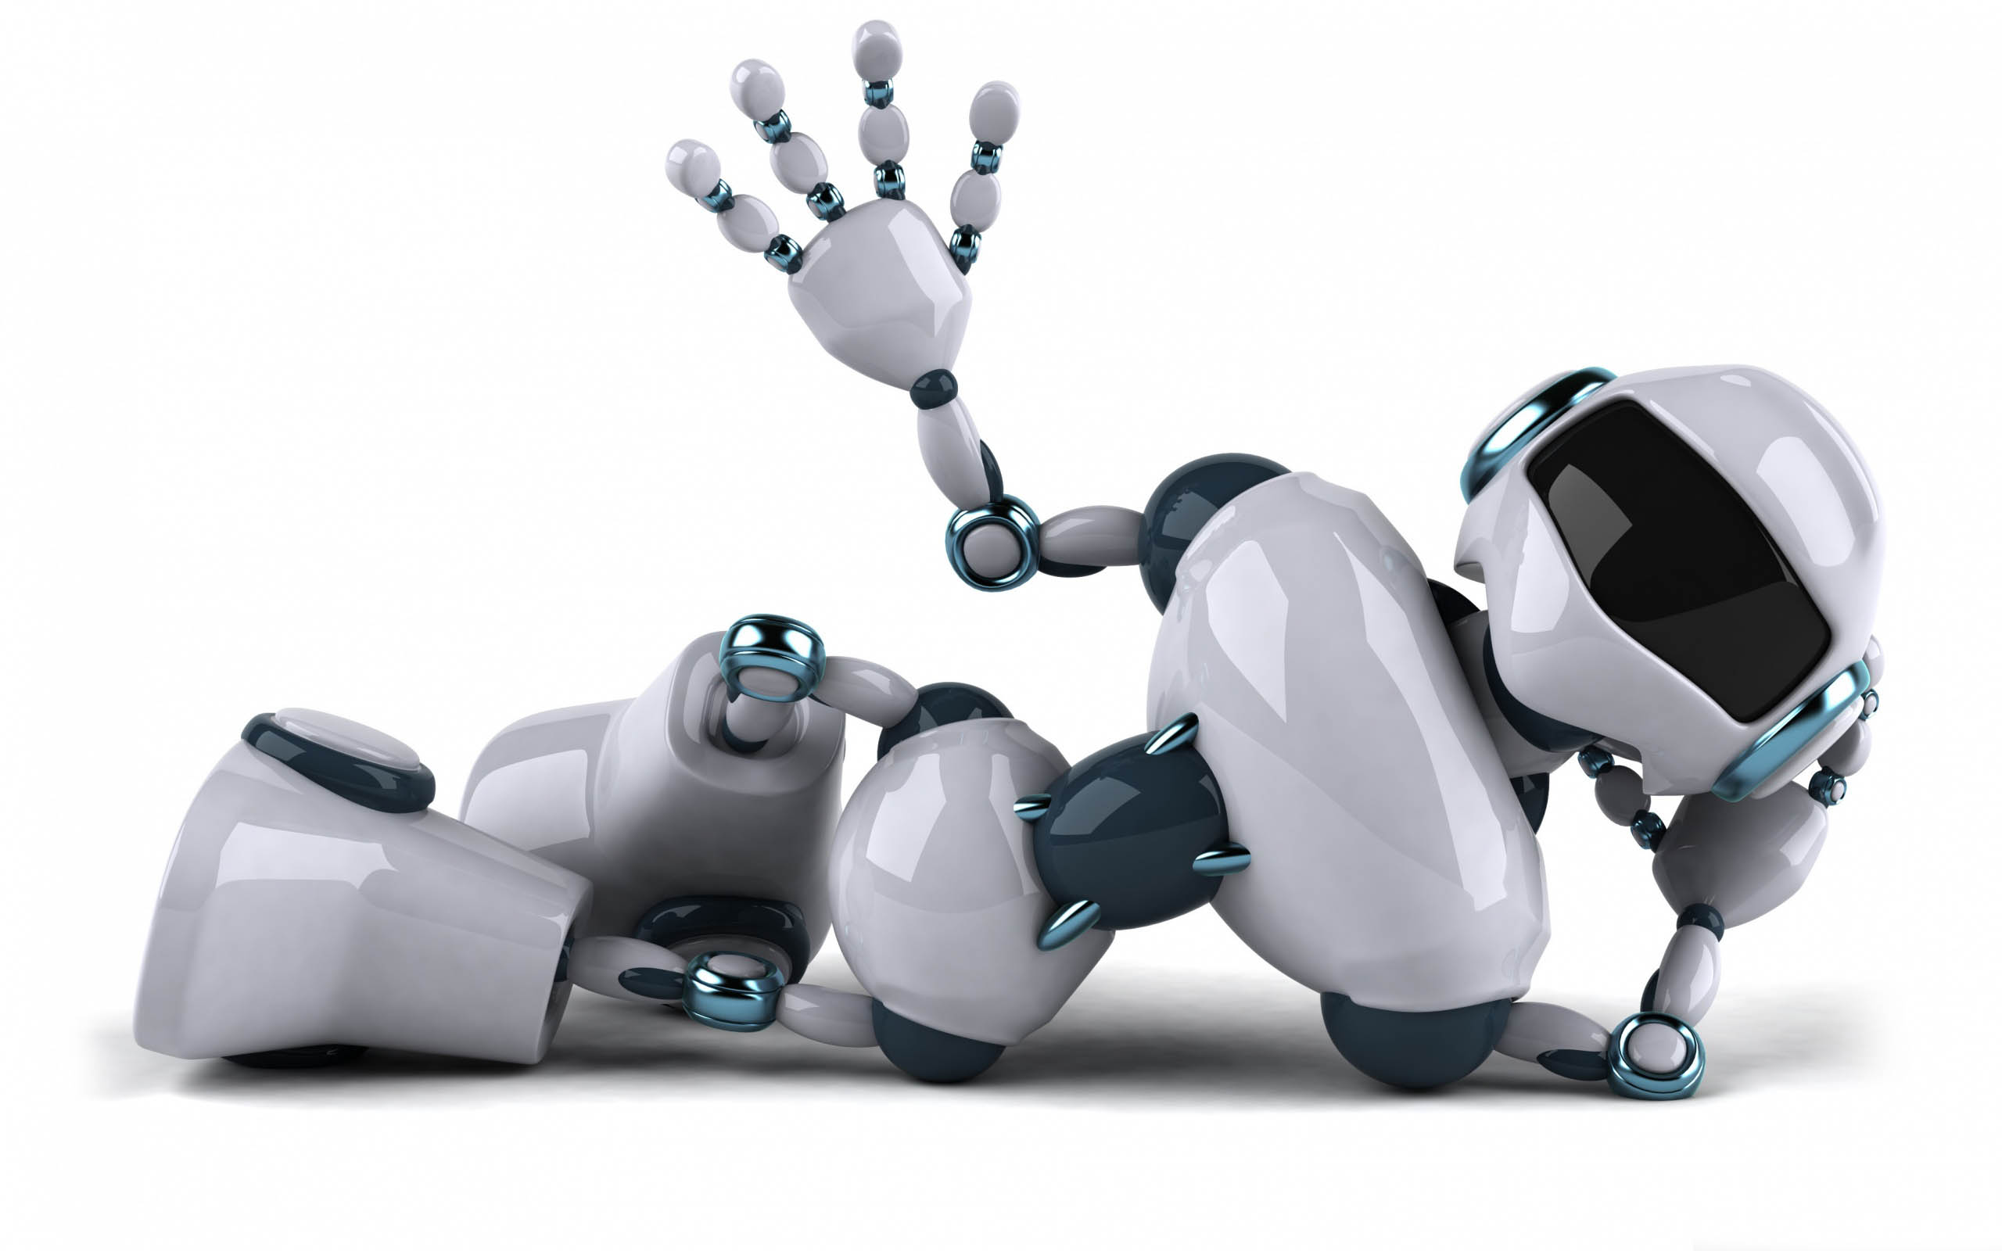
The Best Sophie
Lab Book
Peter+Tony+Carl+Vincent=Sophie

Slide 2
Problem
Many TV programs and movie are booooooooooring!
Mission
Our mission is to produce and direct a way cool super hero story!

Slide 3
Program primitives
Iteration
Conditional statements
Variables
Message
Sequence vs. Parallel
Modular programming

Slide 4
Problem Solving Tricks
1)Focus-Identify the problem and set goals.
2)Research-Don’t re-invent the wheels.
3)Teamwork-Share ideas.
4)Simplify-Break your solution into simple parts.
5)Document-Keep a lab book.

Slide 5
Story—Megatron save the Cabertron
The story happens on the cabertron. The character is Megatron-the leader of the deceptions. The time is in 2099, and there are no wars on the planet, so Optumes Prime goes to have a holiday.
After Optumes Prime leaves, because of the transformers always waste a lot of energy, the cabertron’s core energy is about to collapse. So the Cabertron is in danger.
When Optumes Prime knows the news, he comes back to Cabertron as quickly as he can. After Optumes Prime arrive at the Cabertron, he and Megatron put their own fires into the core energy and save the Cabertron, but kill themselves.

Slide 6
Story—Megatron save the Cabertron
The cars and the deceptions are very sad when they know their leaders were died. So they set up a memorial for Optumes Prime and Megatron. And live on the peace ever after.

Slide 7
Things We Learnt
Peter:
I learnt a lot of things in this project, and I think they are all very important. Such as we should teamwork, then we can do the project easier. And we need to be very careful when we use the tools, or we may hurt ourselves. Besides, we are better to keep a lab book, so we can know what we’ve done before, and re-think the things we’ve done.
Tony:
In this week, we make a robot of Megatron. When we make the Megatron, I learnt some very important rules. Such as teamwork, research and focus.
Vincent:
I learnt a lot of things and I think they are interesting. We learnt how to program, make a puppet of Megatron, and make a coin sensor. And put a microcontroller, a servo and a light sensor on it.
Carl:
We make a puppet. It can move. It can connect the computer. We learned Scratch
Programming is very well. We learned how to surf the Internet. We learned how to teamwork. We learned how to make the puppet move when press the space bar.

Slide 8
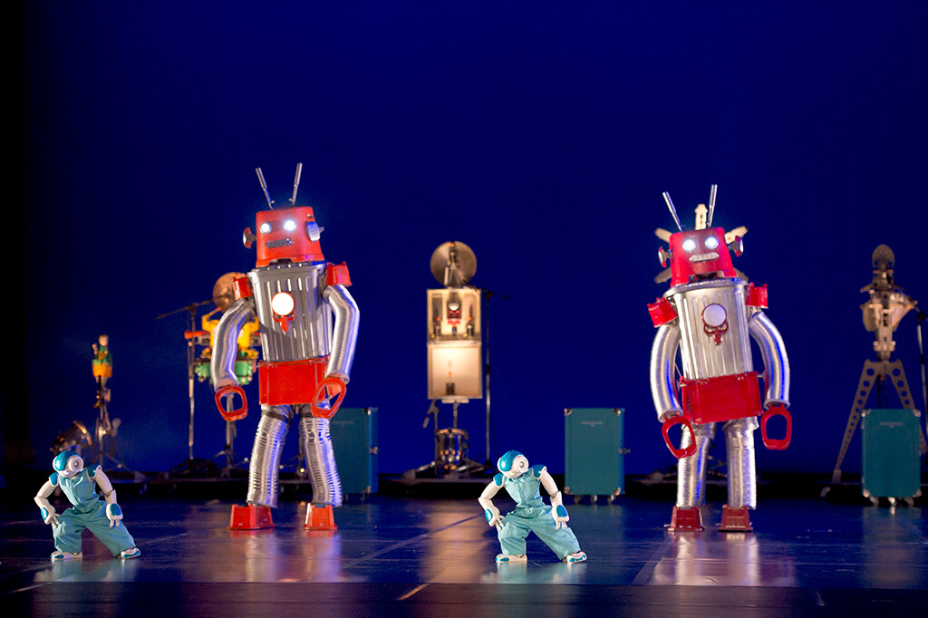
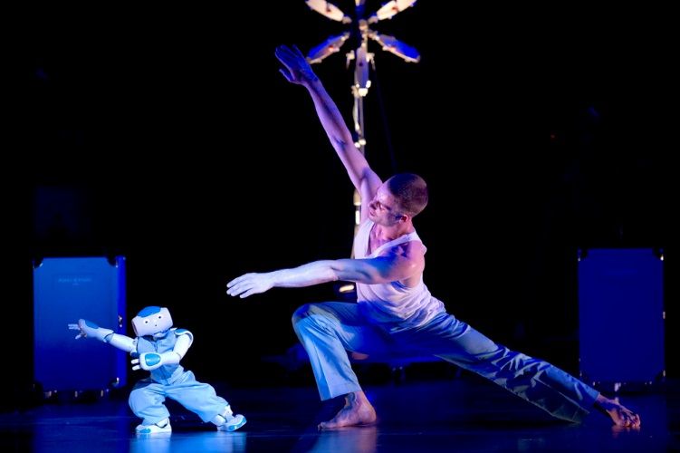
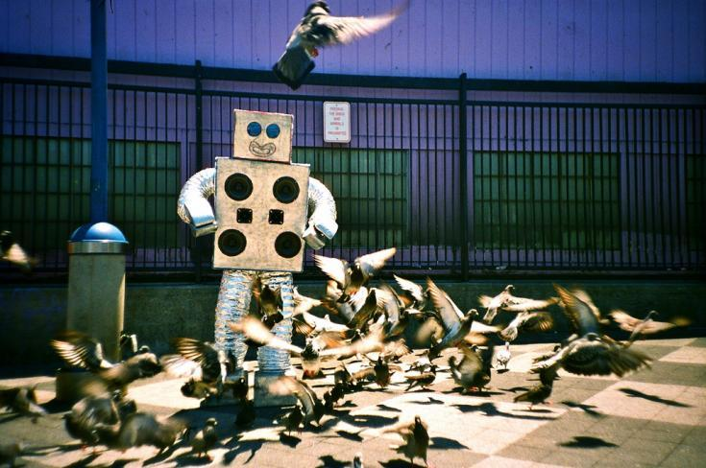
Research

Slide 9
THANK YOU
very much

